Slide 1

Expense Manager
RoboGarden CapStone Project Showcase Presentation
Runzi Mu, Aug 22, 2023

Slide 2
“Do not save what is left after spending, but spend what is left after saving.’’
- Warren Buffett

Slide 3
Expense Manager
A managing tool that makes people’s life easier

Slide 4
Explore My Users
Each person is different
It’s important to think broadly to capture as much diversity as I can.
Major Target Users
College Students
Age
18 - 22
User’s everyday environment
Having class everyday, usually have lunch or dinner at school (busy schedule!!)
Their challenge
At the end of the day (time period), they may notice they are running out of budget
What do they want in a solution that would make their lives easier
They want an easy and simple way to track their expenses, so they can better manager their money
Specific circumstances they might use an app that address their challenge
Whenever they made a transaction or at the end of the day

Slide 5
Consider Diversity
Diversity, because belonging takes all of us
A user’s identity and circumstances will have a huge impact on how they’ll experience and use an app.
Additional Target Users
Working Professionals and Financial Organizations and more!
Age and Gender
All age, All genders
Languages and Cultures
Multilingual, All Cultures
Disabilities
Individual with difficulty seeing or hearing
What do they want in a solution that would make their lives easier
An tool that provides multiple languages and accessibilities

Slide 6
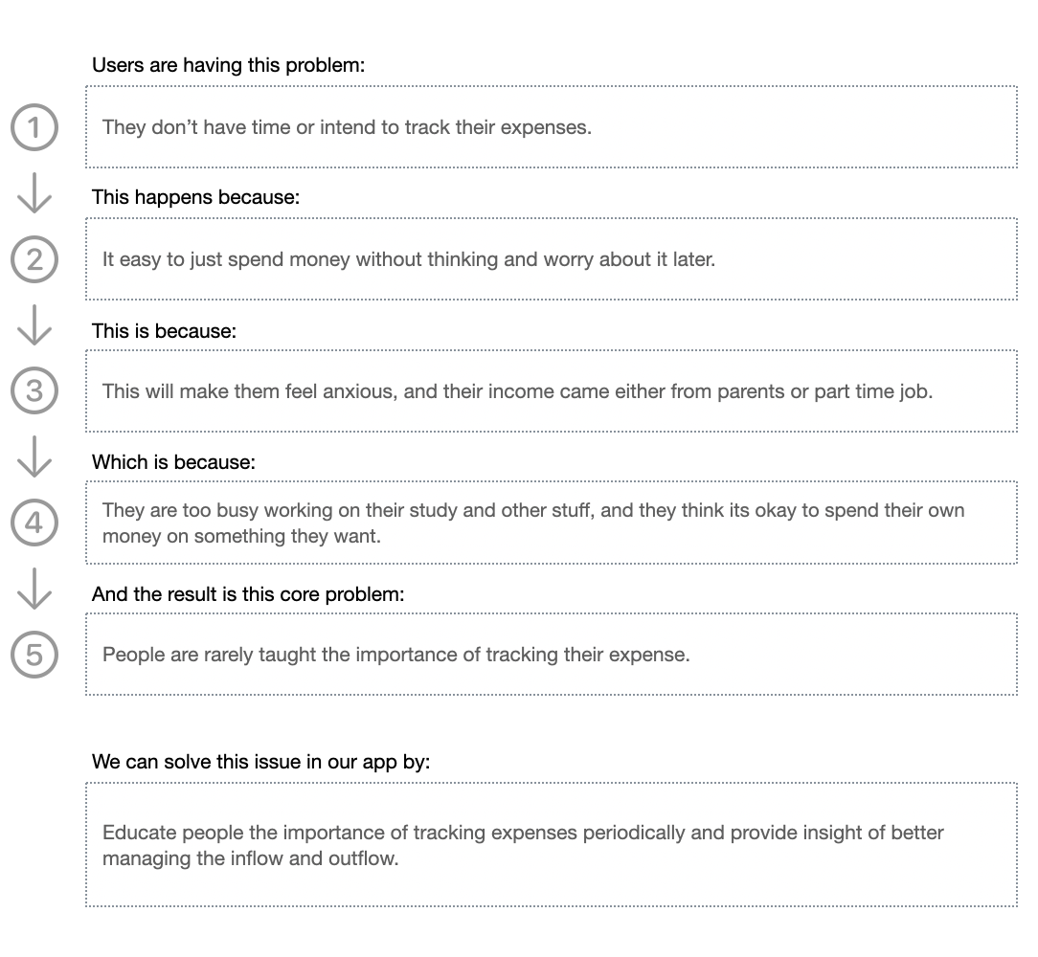
Causes
The more you dig, you more you would gain

Slide 7

Runzinizer
An expense Managing tool that help lives gets easier

Slide 8
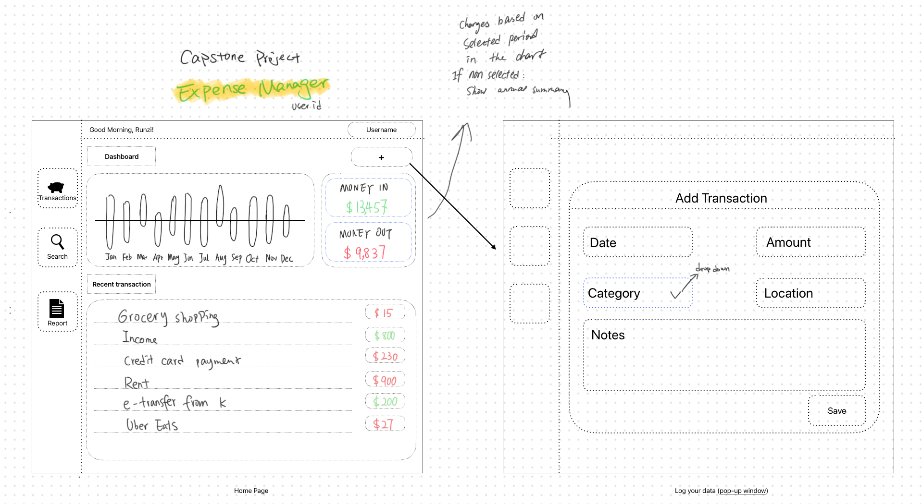
Initial project mockup
Where ideas spark

Slide 9
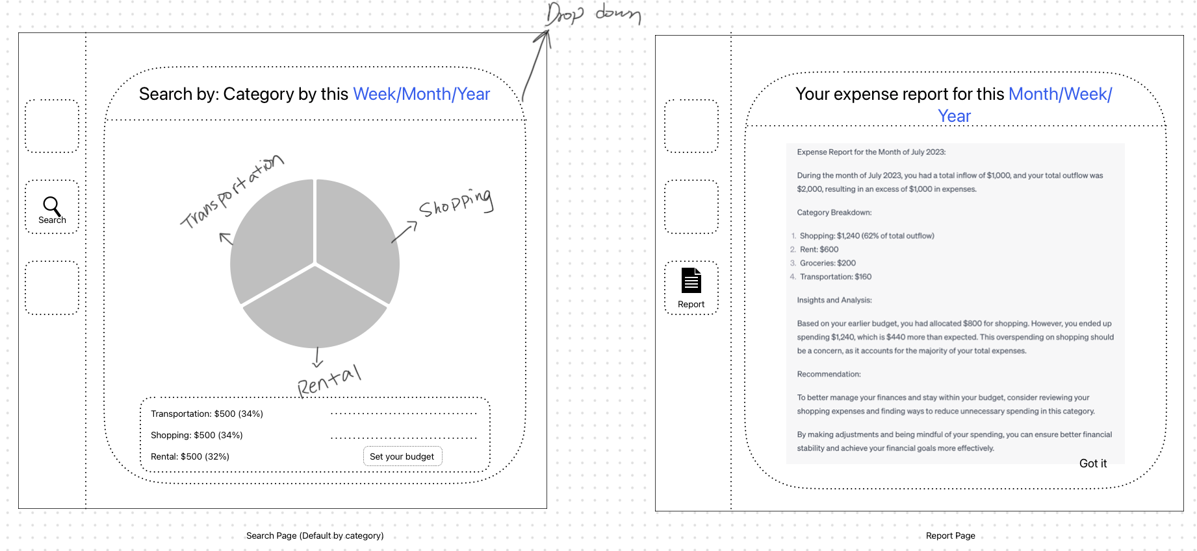
Initial project mockup
Where ideas spark

Slide 10
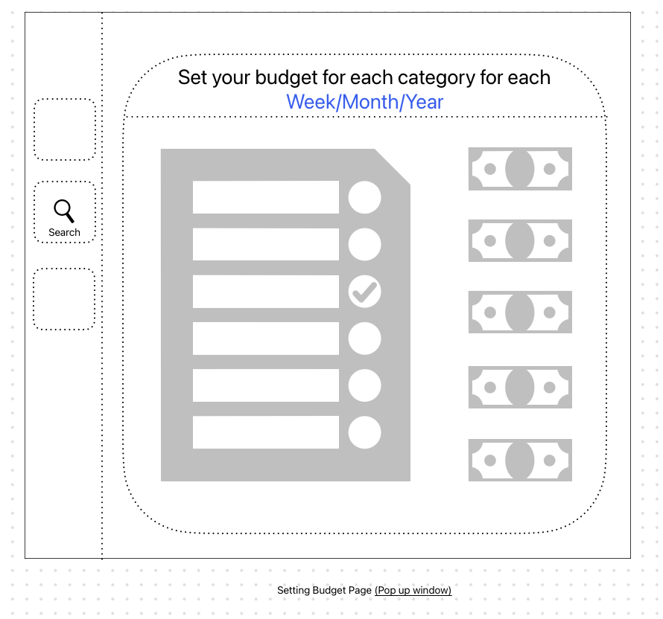
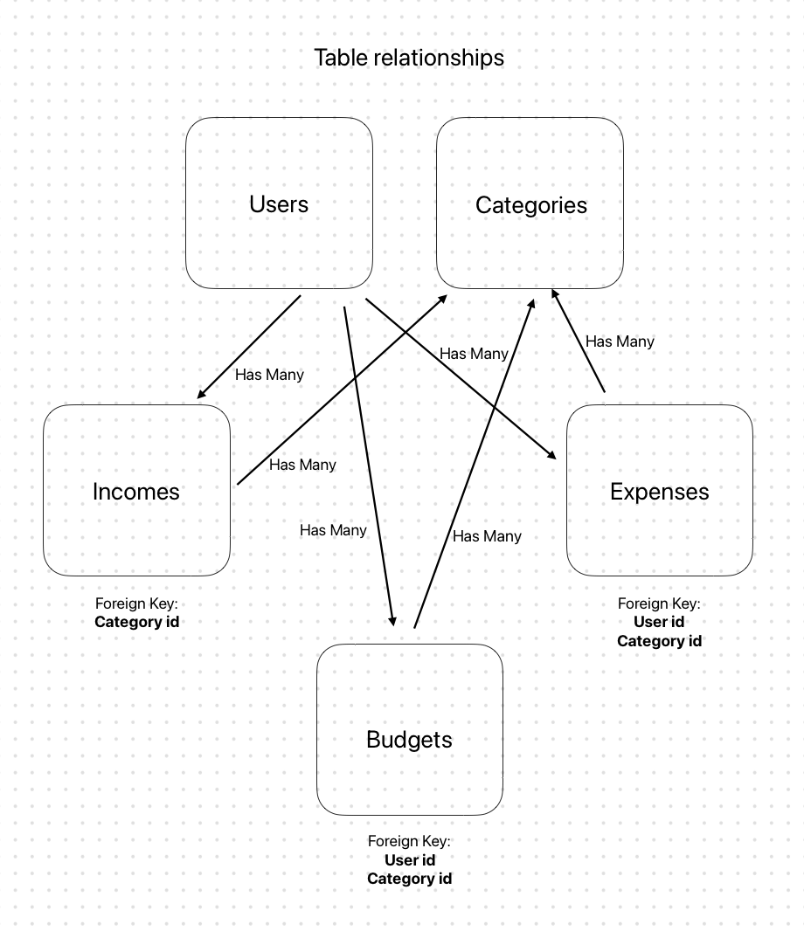
Initial project mockup
Where ideas spark

Slide 11
Database Design
User Table
Category Table
Expense Table
Income Table
ID
Email
Password
First name
Last name
ID
User ID
Category ID
Description
Amount
Expense date
ID
User ID
Description
Amount
Income date
Category ID
ID
Category name

Slide 12








Technologies I used

Slide 13
Problems I faced
Finding an effective way to fix bug
Time Management
Motivation
Self-Confidence

Slide 14
How would I market & sell Runzinizer
Ads keep Runzinizer free
Free Version 🩵
Premium Version ($12.99/lifetime) 💎
All Essential Features
With Ads
All Essential Features
Add multiple accounts
Set Budgets
Link to personal bank
No Ads

Slide 15

Demo Time

Slide 16
Thank you!

